Slide 1
Comparison of virtual reality rehabilitation and conventional rehabilitation in Parkinson’s disease: a randomised controlled trial
Physiotherapy 2019
Impact Factor: 2.478

Slide 2
Introduction
1. Parkinson’s disease (PD) is one of the most common neurodegenerative (神经变性) diseases, affecting one to two per 1000 population, and its prevalence increases with age.
2. Despite pharmacological (药理学) and surgical approaches, physiotherapy represents a key role in symptom management.
3. Approaches to physiotherapeutic rehabilitation in PD can be conventional (e.g. aerobic exercise, treadmill, stretching and resistance exercises) or non-conventional (e.g. dance, Tai Chi).
4. The aim of this study was to compare the efficacy of a VR rehabilitation programme with a conventional programme in patients with PD.

Slide 3
Methods
1. Participants
(1) 51 patients were enrolled in the study (35 males, 16 females)
(2) Inclusion criteria
(a) Ability to perform the rehabilitation programme with a low risk of falling
(b) Ability to perform motor rehabilitation independently
(c) Absence of cognitive impairment (Mini-Mental State Examination score >25)
(d) No changes in drug therapy for PD during the rehabilitation programme
(3) Exclusion criteria
(a) Severe hearing loss and/or visual deficit
(b) Serious comorbidities (并发症) making it impossible to perform rehabilitation
(4) 26 patients underwent conventional rehabilitation and 25 patients underwent VR rehabilitation.

Slide 4
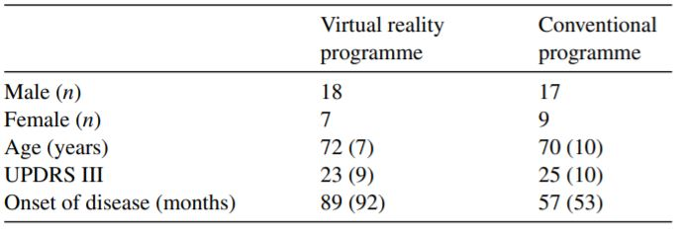

Slide 5
Materials and Methods
2. Rehabilitation programmes
(1) Patients underwent the conventional or VR rehabilitation programme for 6 consecutive weeks, involving a 40-minute session three times per week.
(2) Conventional rehabilitation programme
(a) Warm-up phase – passive mobilisation of main joints and muscular strengthening of lower limbs.
(b) Active phase – exercises of motor coordination with upper and lower limbs, balance training, start and stop exercises, and walking training.
(c) Cool-down phase – manipulation exercises, mobilization exercises and respiratory exercises.

Slide 6
Materials and Methods
2. Rehabilitation programmes
(3) VR rehabilitation programme
(a) Wall projector, infrared camera.
(b) Exercise 1: To touch a moving trumpet displayed on the wall screen.
(c) Exercise 2: To touch a rose projected on the wall screen as a hemiarc.
(d) Exercise 3: To lead a dog to the four corners of the wall screen.
(e) Exercise 4: To touch eggs projected on to the wall screen in a random order as quickly as possible.
(f) Exercise 5: To reach a mole that came out from a hole.
(g) Exercise 6: To perform a motor task as indicated by the physical therapist while maintaining balance between two lateral bars.
(h) Exercise 7: To clear all the leaves projected on to the wall screen as quickly as possible.

Slide 7
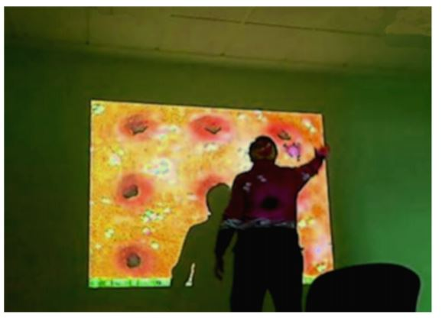

Slide 8
Materials and Methods
3. Outcome Measurements
(1) The Berg Balance Scale (BBS)
(2) The Dynamic Gait Index (DGI)
(3) The Disabilities of the Arm, Shoulder and Hand (DASH) scale
(4) Ad-hoc scales for liking the programme, difficulty of the programme and fatigue after physical therapy
(5) Short Form-36 (SF-36)

Slide 9
Results
1. The VR rehabilitation programme led to an increase in BBS score, DGI score and SF-36 mental composite score, and a decrease in DASH scale score.
2. The conventional rehabilitation programme only led to a decrease in DASH scale score.
3. Between-group differences were found in liking the programme and fatigue after physical therapy, but no between-group difference was found for difficulty of the programme.

Slide 10
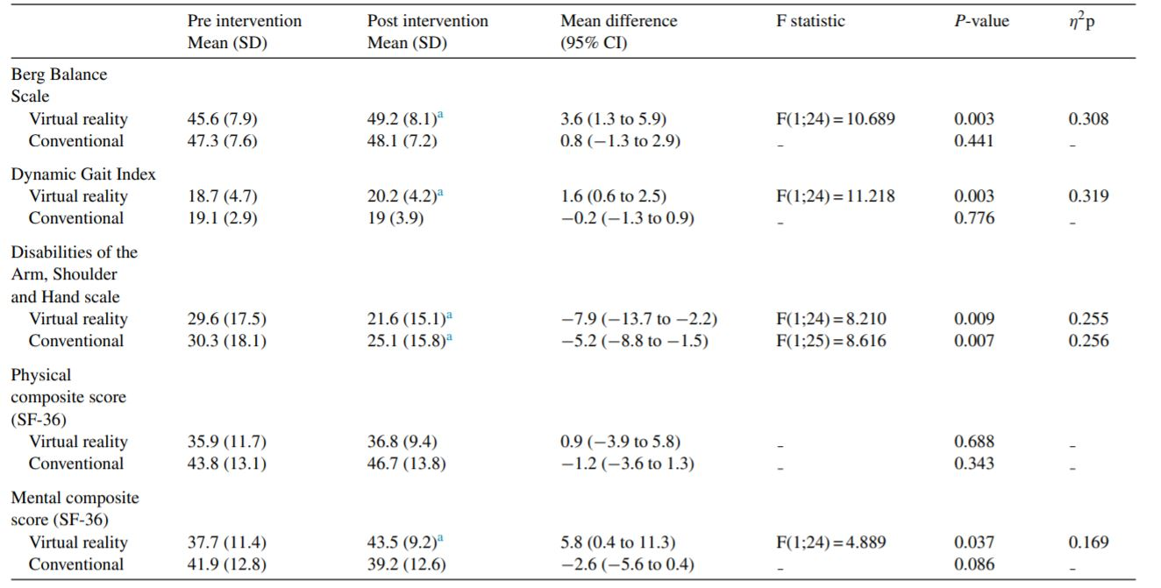

Slide 11
Limitations
1. This was not a crossover study.
2. Follow-up data were not collected so the duration of improvement is not known.
3. The proposed set of virtual exercises did not represent daily activities.

Slide 12
Conclusion
1. VR rehabilitation is more effective in determining overall improvement (gait, balance, upper limb function and mental aspect of quality of life) compared with conventional rehabilitation in a safe and stimulating setting.
2. More studies are needed to confirm these data in a wider sample of patients to evaluate the possible effects on activities of daily living.

